Slide 1







CENTER OF EXCELLENCE
Biobanking and the Cyprus Human Genome Project

Slide 2
Biobanking and the Cyprus Human Genome Project
CY-BIOBANK │ Grant Agreement Number: 857122
Project Title: Center of Excellence – Biobanking and the Cyprus Human Genome Project
Funding: European Commission
Project duration: 15 years │ European funding for years 1-7
Program: H2020-WIDESPREAD-01-2018-2019: Teaming Phase 2
Project Budget: European Commission: €15 million
Republic of Cyprus: €15 million
University of Cyprus: €8 million
PARTNERS
University of Cyprus Cyprus
Medical University of Graz / BBMRI.at Austria
Biobanking and BioMolecular Resources Research Infrastructure-
European Research Infrastructure Consortium / BBMRI-ERIC Austria
4. RTD TALOS Limited Cyprus

Slide 3
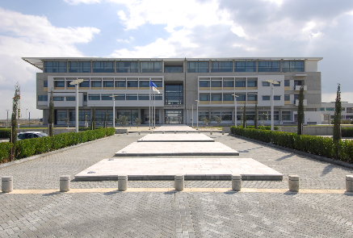
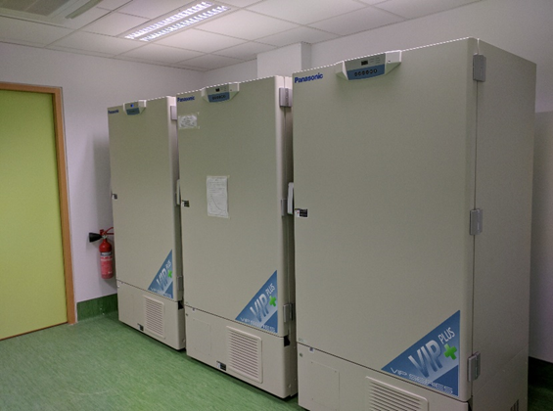
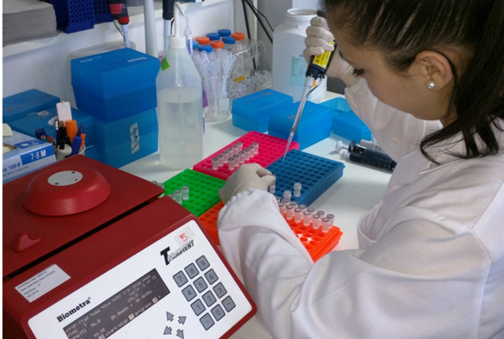
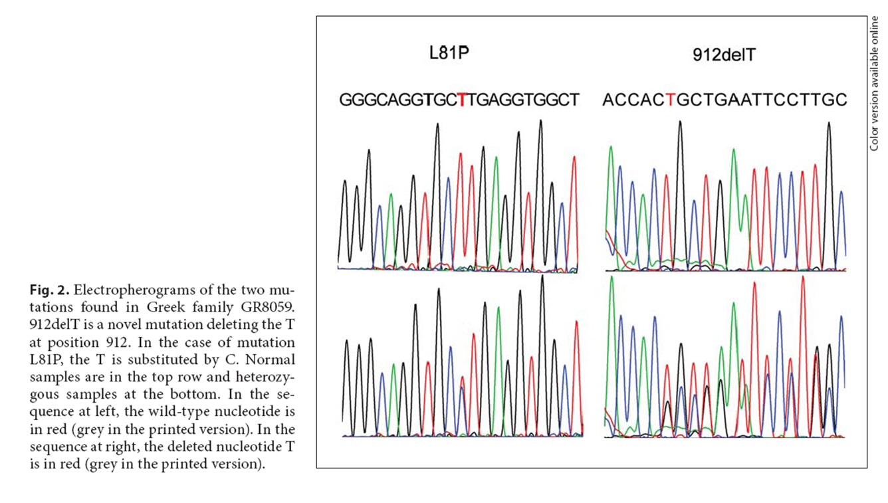
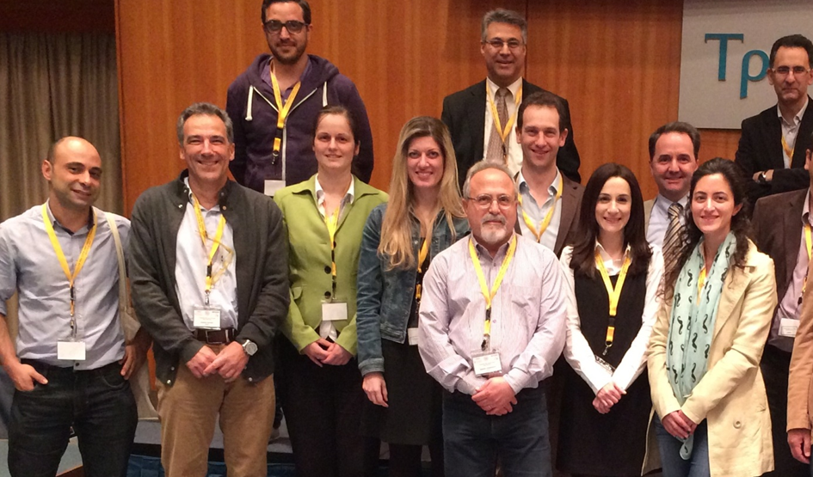
University of Cyprus
(UCY)
Molecular Medicine Research Center (MMRC)
GOVERNANCE:
Director
Academic Council & Research Unit Council
Stakeholders’ Forum
International Advisory Committee
Biobank
Medical
Translational
Research
Molecular Diagnostics Services
Continuous
Education
& Training

Slide 4
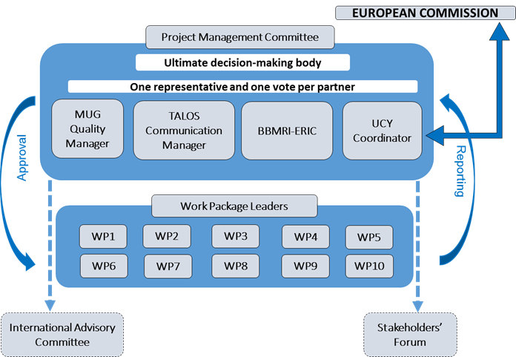
3.2 Management structure and procedures

Slide 5
Table 3.1a: List of WPs (note that Person-Months shown refer to those covered by the EC grant, the Complimentary grant and the Total) │L-P: Lead Partner │ P-M: Person-Months │ Total P-M: The sum of P-M funded by all sources, years 1-7
WP | Work Package Title | L-P No | L-P Name | EC funded P-M | Start Month | End Month | Complimentary Person-Months | Total P-M
1 | Project Management and Communication | 1 | UCY | 76 | 1 | 84 | 412 | 488
2 | Physical premises & equipment infrastructure | 1 | UCY | 40 | 1 | 36 | 70 | 110
3 | ICT Operations, Quality & Sample Management | 2 | MUG | 313 | 1 | 84 | 32 | 345
4 | Bioinformatics & eHealth | 1 | UCY | 275 | 1 | 30 | 29 | 304
5 | Create a state-of-the-art Biobank | 1 | UCY | 1,072 | 25 | 84 | 69 | 1141
6 | The CHGP & other res. projects | 1 | UCY | 420 | 1 | 84 | 1008 | 1428
7 | Dissemination of results, education / training & other acad. activities | 4 | TALOS | 225 | 1 | 84 | 0 | 225
8 | Ethical, Legal & Social Implications | 1 | BBMRI-ERIC | 70 | 1 | 12 | 0 | 70
9 | IPR management, innovation and market exploitation strategy | 1 | UCY | 71 | 13 | 84 | 0 | 71
10 | Business development and sustainability | 4 | TALOS | 383 | 13 | 84 | 172 | 555
 | Total P-M |  |  | 2,945 |  |  | 1,792 | 4,737
Equivalent to nearly 400 years

Slide 6
GANTT CHART

Slide 7
Table 3.1b.i: Projects to be developed and banking activity in a disease-oriented strategy in Y1-7 & Y8-15
PROJECT | TASK Leader | Target Number of Donors (Years 1-7)
TASK 6.1: Human genome project, 500 family trios | A. Malatras | 1,500
TASK 6.2: Cyprus initiative on rare & undiagnosed diseases | V. Anastasiadou | 300 (50*)
TASK 6.3: Cyprus Chronic Kidney Disease (CKD) registry | K. Ioannou | 2,500 (200*)
TASK 6.4: Genetic modifiers for inherited glomerulopathies | K. Voskarides | 2,000 (600*)
TASK 6.5: MUC1 kidney disease & relatives to serve as healthy controls (250 + 250) | G. Papagregoriou & C. Stavrou | 500 (150*)
TASK 6.6: “The Cyprus Study”, a population cohort study on Atherosclerosis & Cardiovascular Disease (CVD) | A. Nicolaides A. Panayiotou | 3,000 (1,100*)
TASK 6.7: Gynaecological cancer epidemiology & genetics | A. Constantinidou | 2,500
TASK 6.8: The Liquid biopsy study in Lung cancer | M. Spiliotaki | 500 (48*)
Others: based on suggestions by the Stakeholders’ Forum, or the Ministry of Health or based on new disease-focused projects | Others | 3,700
SPECIFIC TARGET FOR A TOTAL (*In parenthesis is number of samples available. However, new follow-up and more complete sampling adds up to make the target of 16,500 donors in Y1-7) |  | 16,500
The numbers are very speculative as new research projects may result in even more intense patient recruitment. The Biobank will be fully prepared to respond |  | Years 8-15
Inherited cardiomyopathies (may be part of TASK 6.2) | To be appointed | 500
Targeted other cancers, such as colon, prostate, brain, etc | To be appointed | 2,000
Diabetes and diabetic nephropathy | To be appointed | 2,000
Alzheimer and other age-related dementias, aging studies | To be appointed | 2,000
Autism and autism spectrum disorders | To be appointed | 500
Others, based on new projects or general population Biobanking | To be appointed | 2,000
INDICATIVE TARGET FOR A TOTAL |  | 9,500

Slide 8
Biobanking and the Cyprus Human Genome Project
General Aims
Centre of Excellence in Biobanking for genetic diseases (medical records, biological material)
Application of the principles of e-Health, data management will be implemented with smart artificial intelligence systems
Completion of the Cypriot Human Genome. Useful for all future genetics studies for all diseases by many researchers
Incubator of dozens of researchers who will improve existing and discover new diagnostic methods for genetic diseases. Discovery of new biomarkers and novel molecular targets for better drugs to treat or prevent diseases, aiming to precision & personalized medicine.
Promote partnerships with groups and networks in European countries, the Mediterranean and Middle Eastern countries, for better understanding of genetic diseases. Attract the interest of pharmaceutical companies. We are starting the MediEuro Network.

Slide 9
Cyprus involvement
University of Cyprus
Cyprus University of Technology (CUT)
Ministry of Health
Organisation of State Health Services (OKYpY)
The medical community, public and private
Bank of Cyprus Oncology Center
The Center for the Study of Haematological Malignancies (CSHM)
The Cyprus Institute (CyI)
The Cyprus Cardiovascular Disease Educational and Research Trust (CCDERT)
Center for Preventive Pediatrics (Limassol)
Federation of Cyprus patients organizations

